Slide 1
Head Prefect Selection Process

Slide 2
What is a Prefect?
A Prefect is a student in Years 10 or 11 who takes on a position of responsibility to lead a team or to contribute to the running of the life of the school.
Prefect positions are highly sought-after as they demonstrate to future employers, Sixth Form Colleges and Universities that you can be trusted with responsibility and are able to deliver when working on a project.
Students apply for the position in Year 10 and serve a ‘Prefect Term’ of Easter of Year 10 until Easter of Year 11

Slide 3
Skills
You will use and develop some of the following interpersonal skills to become a caring, confident and capable student:
Collaborating and working well together with others
Clear communication skills
Organisational skills
Being good at team building and at building trust
Time management skills
Caring about other people
Encouraging and inspiring people to do their best
Inspiring and motivating others to active greatness
Listening well
Public speaking and presentation skills
Respect for everyone, no matter who they are

Slide 4
Head Prefect
Public Speaking such as Year 6 Open Evening
Meetings half termly with Mr Law to introduce new ideas and discuss general matters for the school body
Meetings weekly with Miss Segal to discuss interview, tours and events coming up such as Christmas Ball
School Council meetings weekly to discuss issues from the form reps and student body
Organise and coordinate the Prefect team
Work with different member of staff to organise events
Tour visitors around school
Interview potential staff

Slide 5
Head Prefect Application Process
Thursday 30th November Head Prefect application assembly led by Head and Senior Prefect Teams
Applications can be collected form website, HOY, aHOY, Year 10 tutors, Miss Segal, Mrs Baxter. EBaxter@combertonvc.org
Thursday 30th November Head Prefect application informal meeting lead by Head and Senior Prefect Teams in HMR at lunchtime
Informal meeting for interested Head, Senior, Prefect candidates, with Miss Segal and existing Head Prefects in HMR at lunchtime
Noon on Monday 8th January Deadline for Head Prefect applications
Deadline for Head Prefect applications. Applications to be emailed to Mrs Baxter EBaxter@combertonvc.org

Slide 6
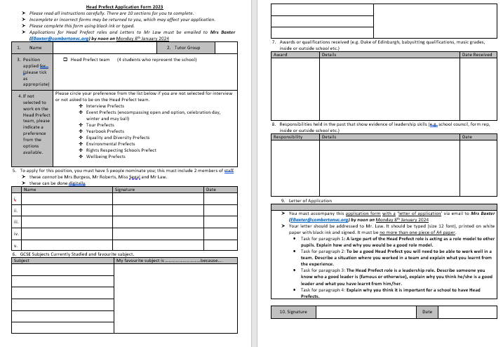

Slide 7
Head Prefect Interview Process
Apply for Head Prefect Team
Selected for Head Prefect Team
2 interviews on one day for position in Head Prefect Team
  Informal interview to present and discuss a topic you are interested in with Miss Segal, Mr Roberts, Year 11 Head Prefect team and Year 7 school council members
  Formal interview to discuss your application form and your role model and other questions with Mr Law, Mrs Burgess, Miss Segal, Governor

Slide 8
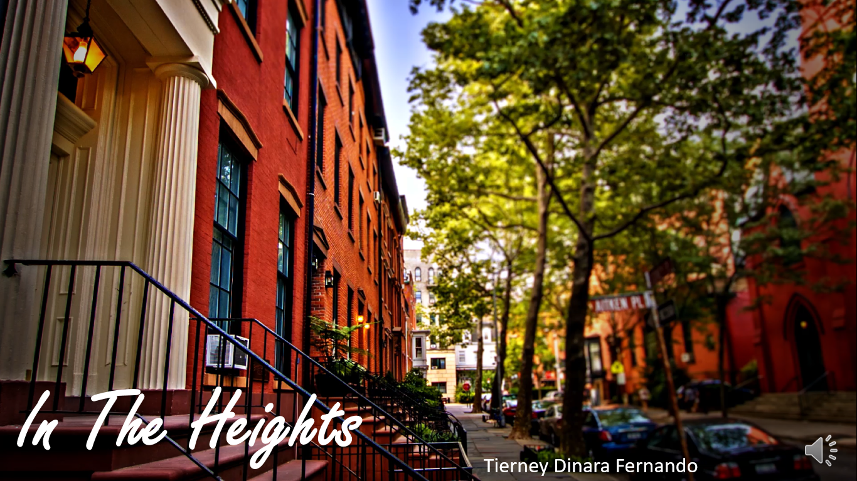


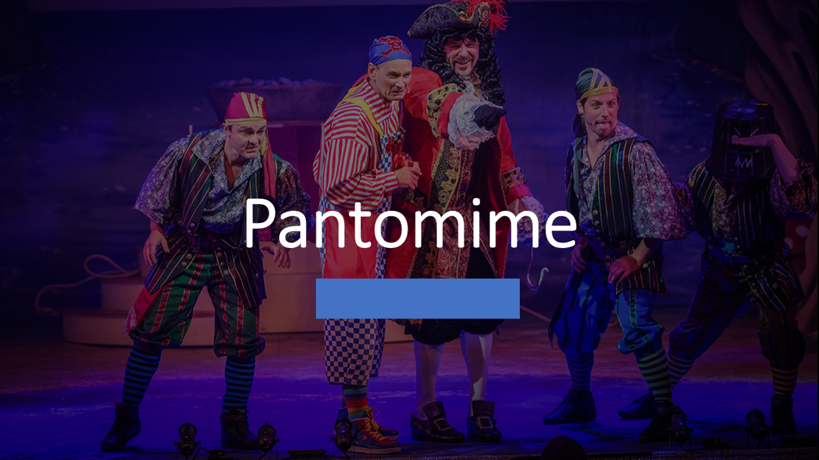



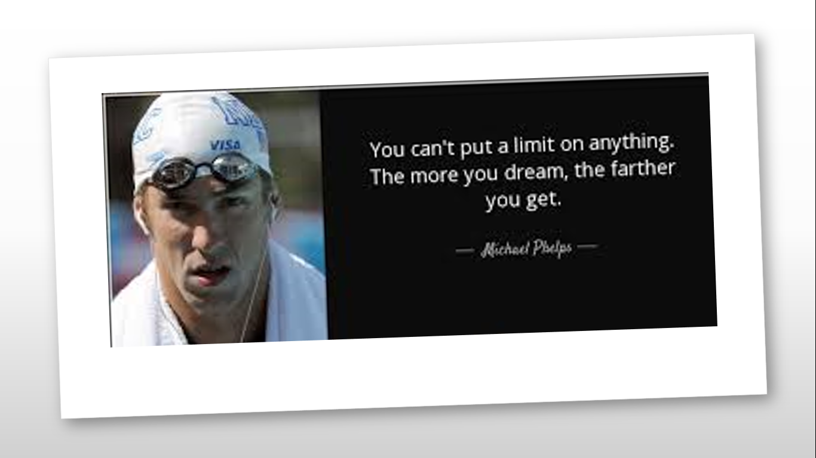

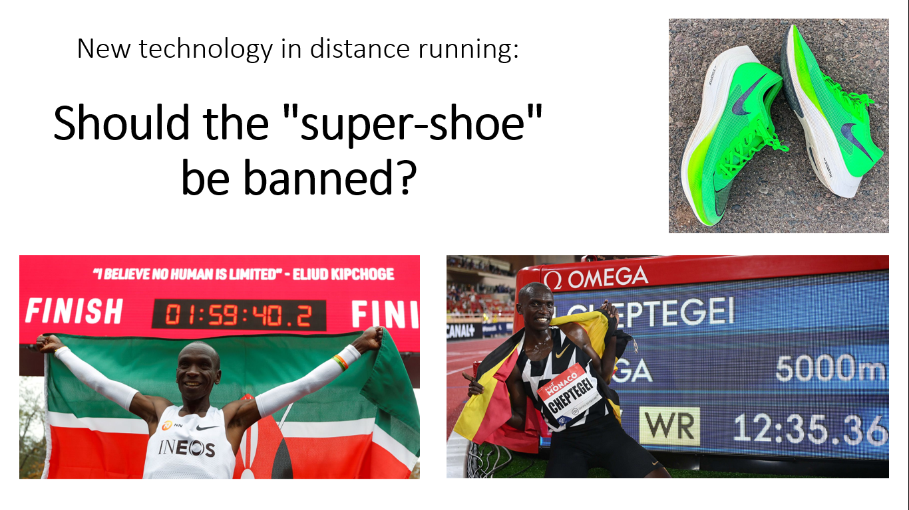

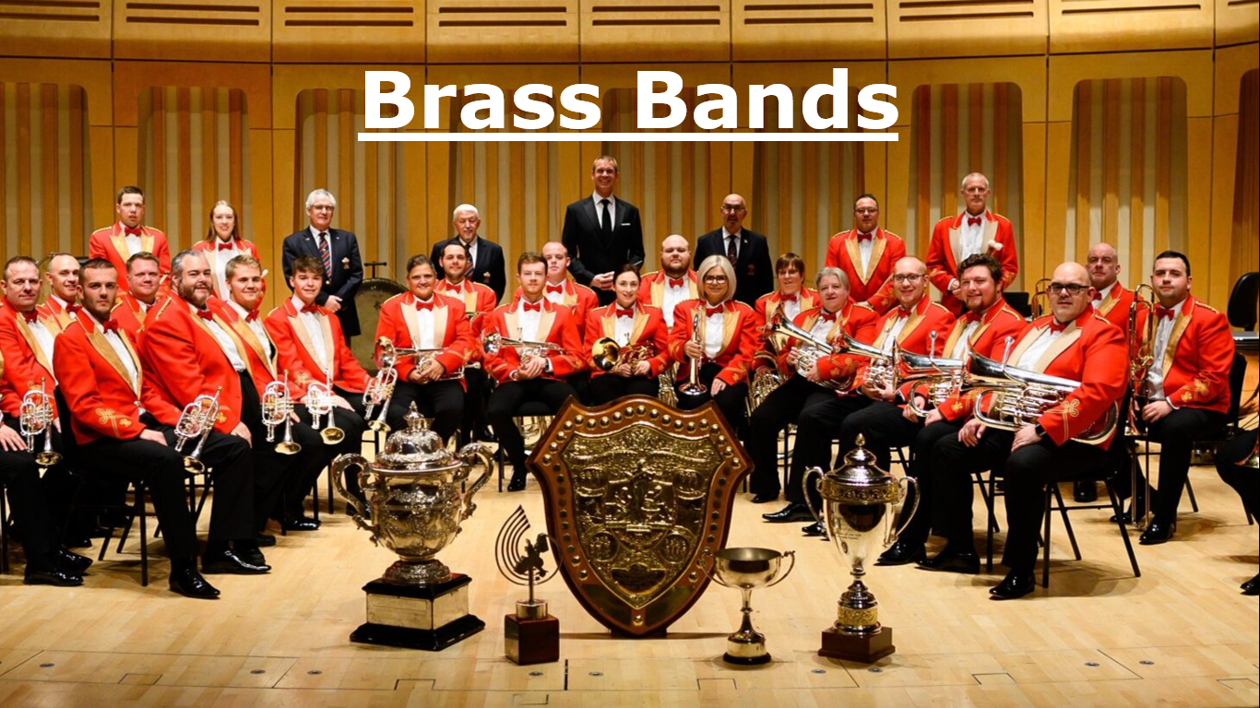

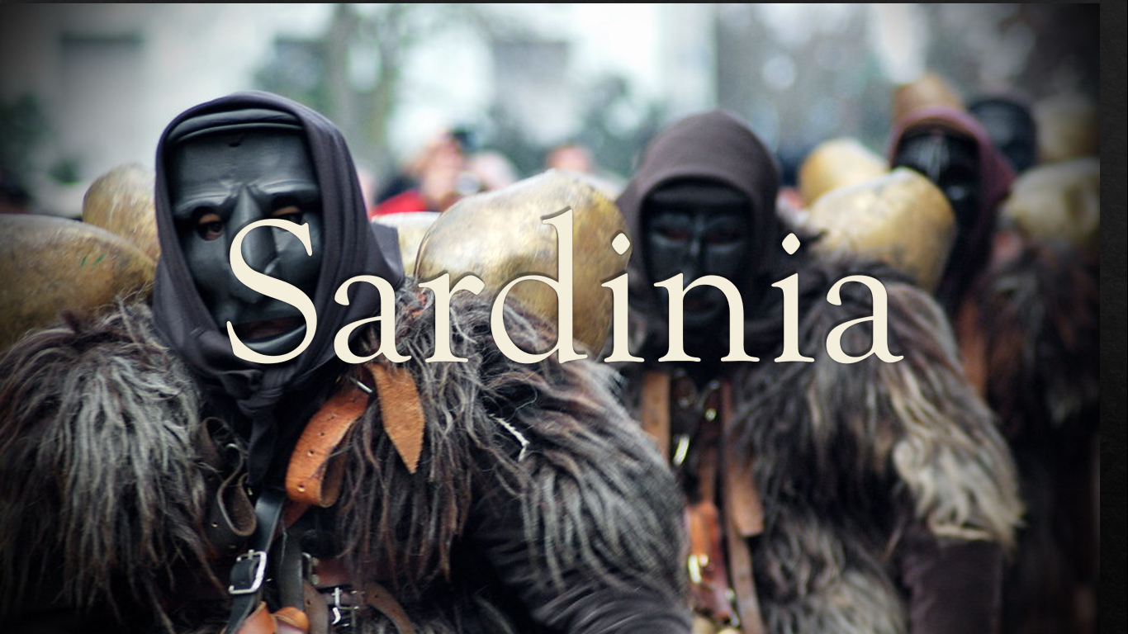
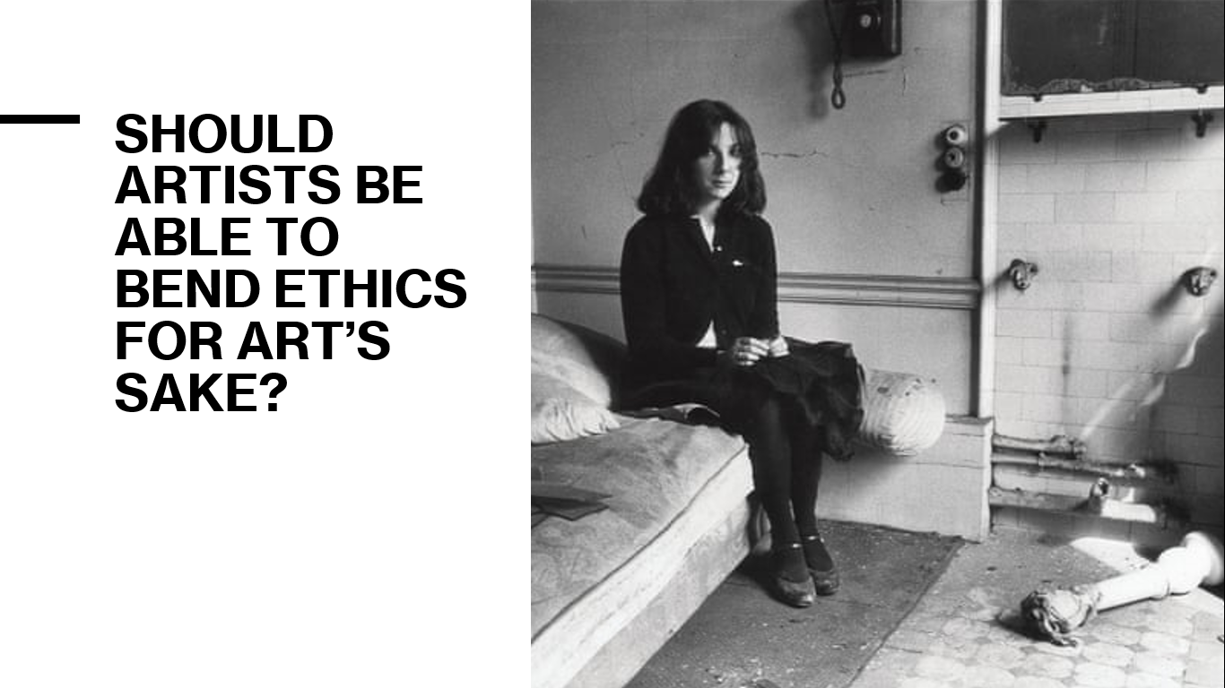

Slide 9
Our experience / tips
Application form:
Put everything on the application form
Read over letter carefully
Over 40 students apply for Head Prefect process
Interview
Prepare – with parent/carer/friends/tutor
Choose a topic you are interested in
Notes:
Leo

